Slide 1

LGE Internal Use Only
Git Fundamental User Guide
Index
Installing and Setup
Git Process
Developer working process
Permission Process
Project Join
Command
Diff merge
2010.
MC Lab / DE Group

Slide 2

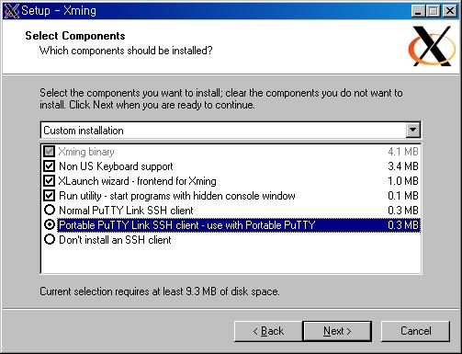
1. Installing and Setup
LGE Internal Use Only
▶ Xming can transport Linux X windows GUI screen to MS Windows window by Putty.
Install package : http://downloads.sourceforge.net/project/xming/Xming/6.9.0.31/Xming-6-9-0-31-setup.exe?use_mirror=cdnetworks-kr-1
1. Install
: Run setup file and select “Portable Putty Link SSH client - use with Portable PuTTY”.
Challenge 1010

Slide 3
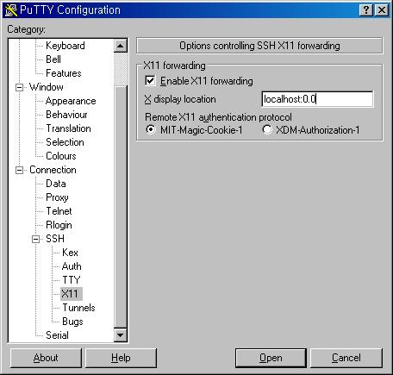
1. Installing and Setup
LGE Internal Use Only
2. Putty setup
- Move to “Connection → SSH → X11”
- Check “Enable X11 forwarding”
- Write “localhost:0.0” to X display location
Challenge 1010

Slide 4
1. Installing and Setup
LGE Internal Use Only
■ Package Install
※ Run as sudo permission account (If it already installed, just skip)
1. Package Install
→ sudo apt-get install git-core kdiff3 sux curl
2. Repo Install
→ sudo curl http://android.git.kernel.org/repo > ./repo
→ sudo chmod 755 /usr/local/bin
→ sudo mv ./repo /usr/local/bin/repo
→ sudo chmod 755 /usr/local/bin/repo
■ Other setting
※ Go on by your linux account on Linux server (that account must same as your AD account)
1. Registering my Information
→ git config --global user.name “Your AD account“ (should same with your AD account)
→ git config --global user.email “Your E-maill“
2. Specifying GUI diff merge tool
→ git config --global merge.tool kdiff3
Challenge 1010

Slide 5
2. Git Process
Git
Process
Workspace
generation
Source Sync
Push
Commit List
checking
Baseline
generation
Commit
Source Edit
Submit
Approve
Add
Verify
<Developer Process >
< Reviewer Process >
< Merger Process >
Repo
Script
build.git
kernel.git
bionic.git
Android is composed of a number of git project.
You can manage those by repo script
dalvik.git
…
prebuilt.git

Slide 6
3. Developer working process
LGE Internal Use Only
Remote
Repository
Local
Repository
Add
-------
-------
-------
-------
Commit
Push
Add
-------
-------
-------
-------
Commit
Commit
Commit
Index
Work
Space
<Remote Server>
<User PC>
Challenge 1010

Slide 7


4. Permission Process
LGE Internal Use Only
[Request permission] - Developer
- Request permission to SW PL
( Name, Organization, ID, Project Name)
[Send approval e-mail] – SW PL
- If requesting developer are legal, SW PL send approval e-mail to SCM manager.
[User registration] – SCM Manager
- SCM manger register users to AD group
[Send complete mail] – SCM Manager/SW PL
- Send complete mail
[Public key generation] - Developer
- Run below command after logon by your account (it should same with AD account)
: ssh-keygen -t rsa
[Gerrit Site Log on] – Developer
- Log on to corresponding Gerrit site
(refer http://git.lge.com)
[Publick Key registering] – Developer
- Log on → Settings → SSH Keys
→ Add Key → Input your Pub key → Add
(Publick key check : cat ~/.ssh/id_rsa.pub )
[Project join] - Developer
- Make empty folder and create workspace by “repo init” command
Developer
SW PL
SCM Manager
Permission
Request
Send
Approval mail
User
Registration
Public key
generation
Send
complete mail
Send
complete mail
Gerrit Site
Log on
Public key
registering
Project
join
Challenge 1010

Slide 8
5. Project Join
LGE Internal Use Only
1. Permission request
2. Workspace generation
: Create a empty folder and get the repo configuration by repo init
→ mkdir “project name” (You can use any name for folder)
→ cd “project name”
→ repo init –u ssh://’Your AD Account’@’Gerrit server IP’:29418/’Project Name’/platform/manifest.git –b ‘Branch Name’
3. Source Sync
: Download and merge to workspace
→ repo sync
4. Setting working branch
: Set the branch that you work
→ repo start ‘branch name’ --all
Challenge 1010

Slide 9
6. Command
LGE Internal Use Only
- File Modification
: You just can modify any editor. (There are no command like check out in clearcase.)
- Add
: It register modified files to Index stage
- File Removing
: There are 2 method to remove file
- Commit
: It register files in Index stage to commit stage.
git add ‘file name’ | Registering specified file to index stage. (It register Untracked file too)
git add . | Registering all modified files to index stage. ( Caution : It register all untracked files too)
git rm file명 | Registering specified file to index stage after removing that file in workspace.
git add -u | First, remove files. And you can register removed files to index by git add –u (Caution: All modified files in workspace will be registered to index stage)
git commit –m “Comment” | Registering files in index stage to commit stage.
git commit –a –m “Comment” | Registering both files in index stage and changes in workspace to commit stage.
Challenge 1010

Slide 10
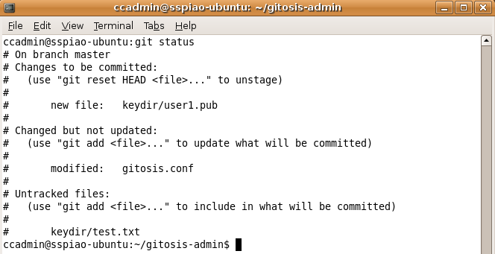
6. Command
LGE Internal Use Only
- Push
: Send commits from Local Repository to Remote Repository. (Do Pull before Push)
git push | Sending commits from Local Repository to Remote Repository.
git pull | Getting changes in remote repository to local repository and workspace
- Checking modification
: Display list of to be added and commited.
git status | Display modified file status (Modified / to be Add/to be Commit)
Files stored in Index stage
It should be commit by
git commit
Modified in workspace
It should be added by
git add
New files
It should be added by
git add
Challenge 1010

Slide 11
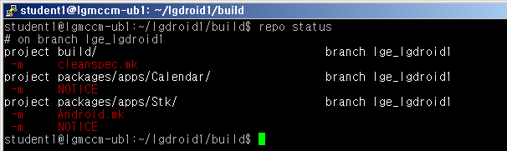
6. Command
LGE Internal Use Only
- Checking status in whole git projects
repo status | Display status of all git projects that is composed by repo script.
Build Project status
Calendar Project status
Stk Project status
※ Status Flag
Index stage | Workspace stage | Description
― | ― | No modification or there are Untracked file
M | m | modified
D | d | deleted
A |  | added
U |  | Unmerged cause by conflict. It need diff merge.
Challenge 1010

Slide 12
6. Command
LGE Internal Use Only
- Rollback to current Head
: It rollback all files that not commit yet to current Head. (It cancel all modified files in workspace and index stage)
git checkout -f | Rollback to current Head.
- Rollback to specified commit
: If you did commit but not push, you can rollback to present commit.
git checkout “commit ID” | It delete commits that since the specified commit (you can get commit ID by git log)
- Unstage files in Index stage
: It unstage specified files from index stage.
git reset HEAD ‘file name’ | Unstage specified files from index stage.
- Rollback modified files in Workspace
: It rollback modified files in Workspace.
git checkout – ‘file name’ | Rollback files to previous of modification.
Challenge 1010

Slide 13
6. Command
LGE Internal Use Only
- Removing all Untracked files
: Remove all untracked files(temporary files like object files).
git clean -f | Remove all untracked files in your workspace
- Checking my current branch
: You should often check your current branch. (repo sync can move you to no branch)
git branch | Display my current branch
- Checking Commit list
: Listing all commit list
git log | Display all commit list
- Command to entire project
: You can command by repo script to all git project that composed by repo.
repo forall –c “git command” | Find all git projects and run git command
Challenge 1010

Slide 14
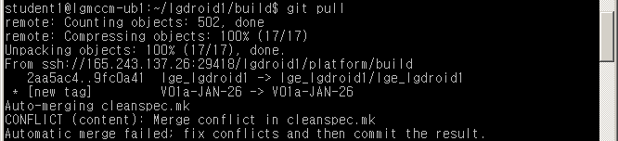
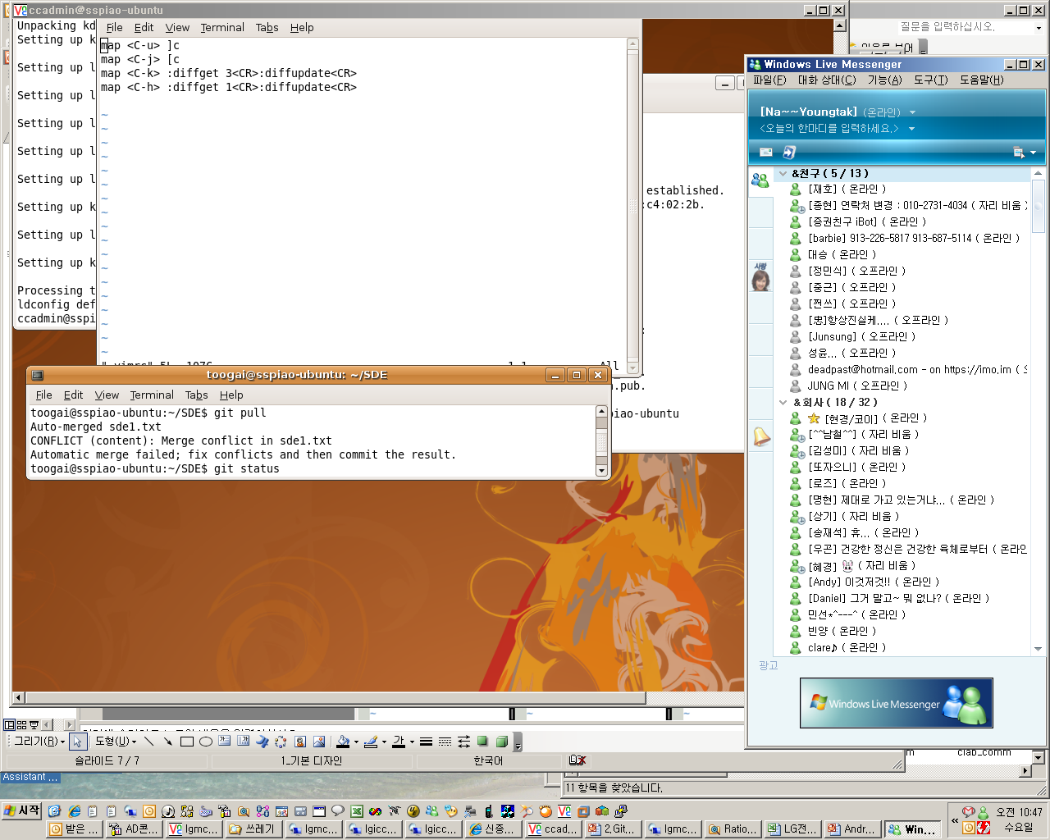
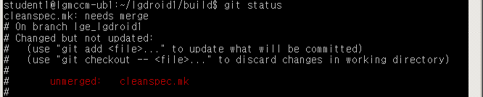
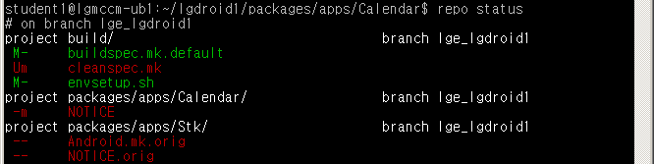
7. Diff merge
LGE Internal Use Only
■ If you meet conflict while Pull operation, you should resolve that. (like ClearCase Diff merge)
1. Check the Conflict
2. Check Conflicted Files
Challenge 1010

Slide 15
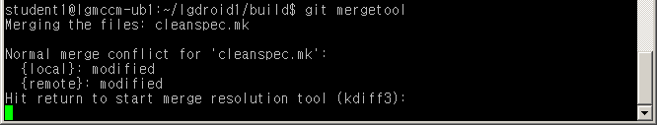
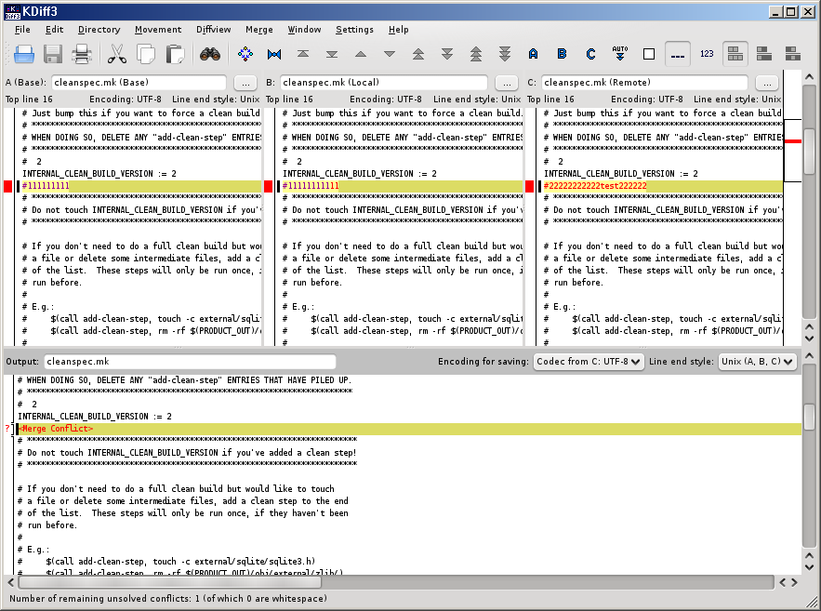
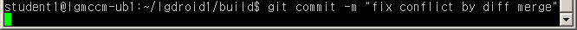
7. Diff merge
LGE Internal Use Only
3. Run Diff Merge tool
4. Resolve conflict (Same usage of ClearCase Diff Merge)
5. Commit Merged file
Challenge 1010

Slide 16
Appendix2. Commands
LGE Internal Use Only
Command | 설명
git add ‘file name’ | Registering specified file to index stage. (It register Untracked file too)
git add . | Registering all modified files to index stage. ( Caution : It register all untracked files too)
git rm ‘file name’ | Registering specified file to index stage after removing that file in workspace.
git add -u | First, remove files. And you can register removed files to index by git add –u (Caution: All modified files in workspace will be registered to index stage)
git commit –m “Comment” | Registering files in index stage to commit stage.
git commit –a –m “Comment” | Registering both files in index stage and changes in workspace to commit stage.
git push | Sending commits from Local Repository to Remote Repository.
git pull | Getting changes in remote repository to local repository and workspace
git status | Display modified file status (Modified / to be Add/to be Commit)
repo status | Display status of all git projects that is composed by repo script.
git checkout -f | Rollback to current Head.
git checkout “commit ID” | It delete commits that since the specified commit (you can get commit ID by git log)
git reset HEAD ‘file name’ | Unstage specified files from index stage.
git checkout – ‘file name’ | Rollback files to previous of modification.
git clean -f | Remove all untracked files in your workspace
git branch | Display my current branch.
git log | Display all commit list
repo forall –c “git command” | Find all git projects and run git commands st
Challenge 1010

